Slide 1





TO DO LIST MANAGER
Never forget to do
SUBMITTED TO - MRS.SHINNU JANGRA
SUBMITTED BY - MANAV TANEJA
MANAN AGARWAL
MANISH RANA

Slide 2

INDEX
INTRODUCTION
PROBLEM STATEMENT
TECHNICAL DETAILS
KEY FEATURES
PROJECT HIGHLIGHTS
CONCLUSION
REFERENCES

Slide 3

INTRODUCTION
NEVER FORGET TO DO ....
To Do is a task management app that helps you manage, prioritize, and complete your goals and tasks.
It offers features such as note-taking, reminders, and due dates.

Slide 4
PROBLEM STATEMENT
TO-DO LIST MANAGER APPS ARE DESIGNED TO HELP YOU KEEP TRACK OF YOUR TASKS AND MANAGE YOUR TIME MORE EFFICIENTLY. THEY ALLOW YOU TO CREATE, ORGANIZE, AND PRIORITIZE YOUR TASKS, SET REMINDERS, AND DEADLINES, AND TRACK YOUR PROGRESS.

Slide 5
TECHNICAL DETAILS
HTML
CSS
BOOTSTRAP
JAVASCRIPT
VS Code Editor
Microsoft Edge
Google Browser

Slide 6


KEY FEATURES
Our website allow you to register your assigned task and deadlines and can also be edited afterwards

Slide 7
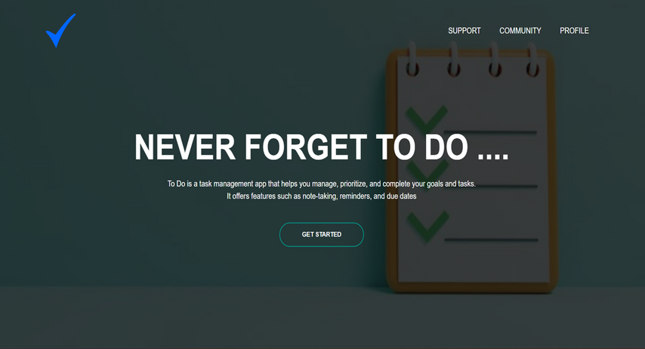
PROJECT HIGHLIGHTS
HOME PAGE

Slide 8
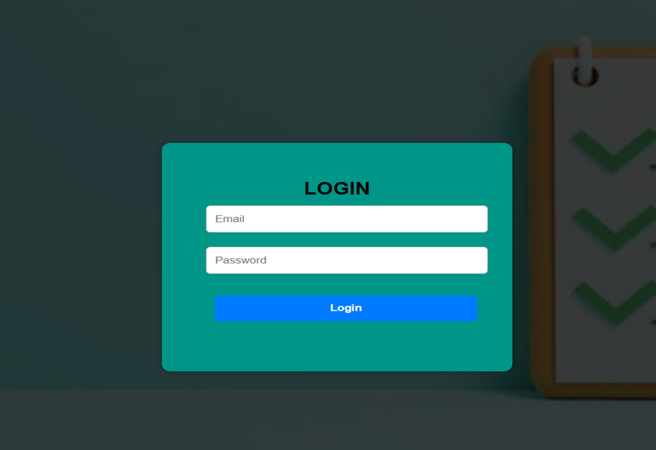
FORM PAGE

Slide 9
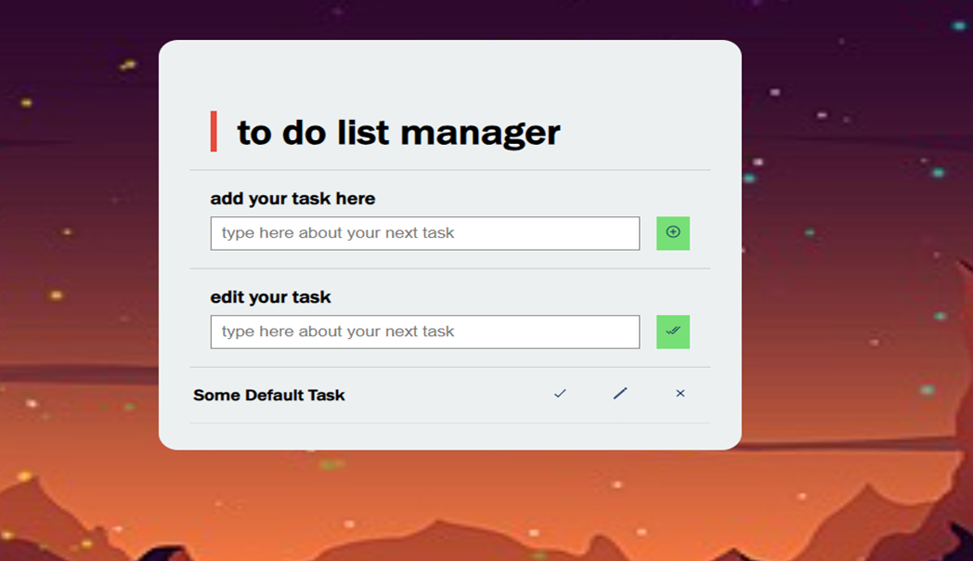
A BREIF HISTORYA Brief Hist

Slide 10
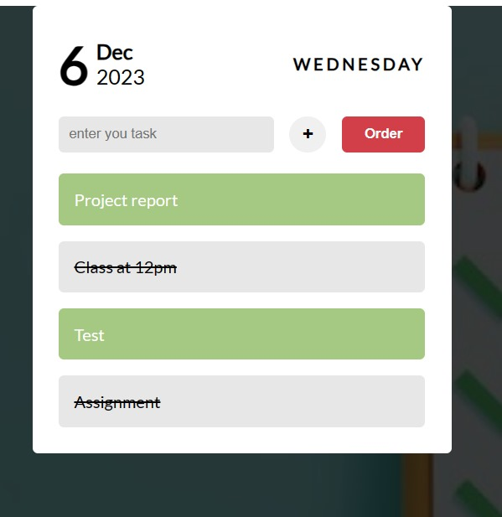
PROJECT GLANCE

Slide 11
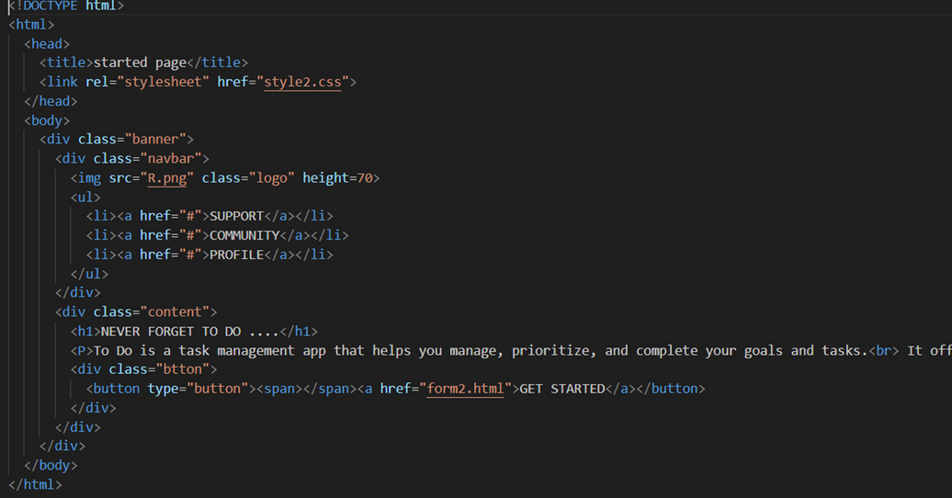
CODE SNIPETS

Slide 12
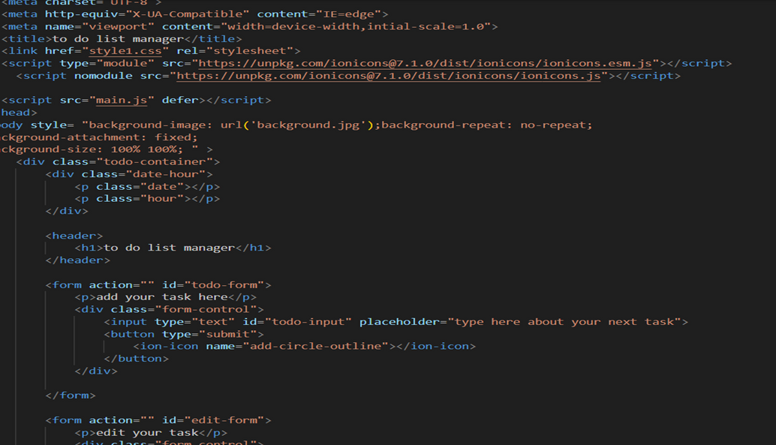
CODE SNIPETS

Slide 13
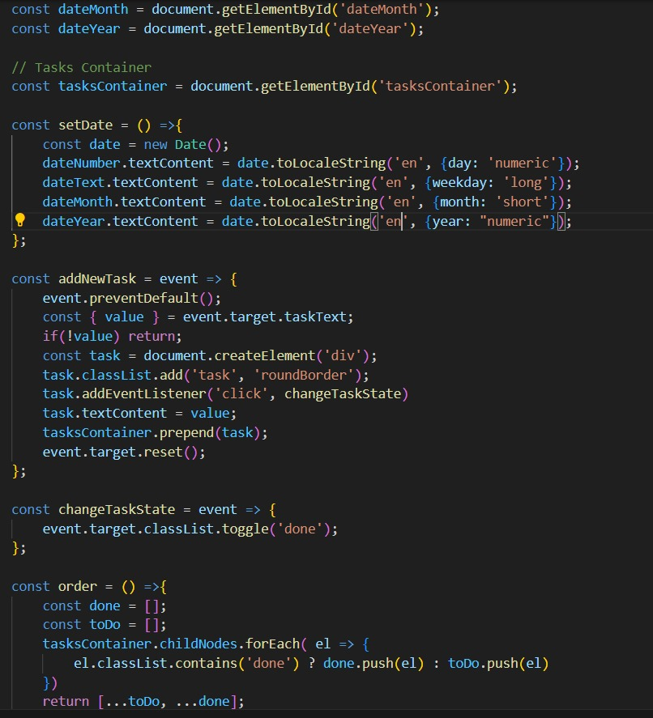
CODE SNIPETS

Slide 14

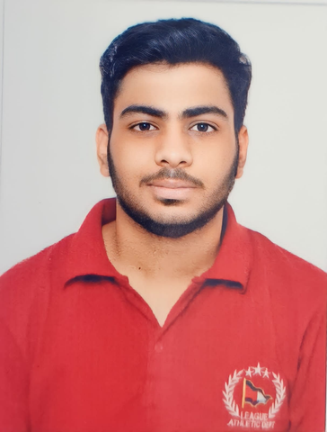

TEAM MEMBERS
MANAV
TANEJA
MANAN
AGGARWAL
MANISH
RANA

Slide 15

REFERENCES/
LINKS USED
THE PROJECT IS DONE WITH HELP OF
OUR VERY SUPPORTIVE FACULTY -
MRS. SHINU JANGRA
YOUTUBE
W3 SCHOOLS

Slide 16
CONCLUSION
THIS PROJECT HELPS THE USER TO PRIORITIES TASK AND BE MORE PUNCTUAL ABOUT THE WORK

Slide 17
THANK YOU
VERY MUCH !!

